Slide 1
Data Science Engineering Methods and Tools Lecture 1
Northeastern University
College of Engineering
INFO 6105 – Spring 2024
Abdolreza Mosaddegh

Slide 2
Course Overview
Course Title: Data Science Engineering Methods and Tools
Course Number: INFO 6105
Term and Year: Spring 2024
Credit Hour: 4
Course Format: On-Ground
Instructor: Abdolreza Mosaddegh
Email : a.mosaddegh@northeastern.edu
TA: Shubham Krishnakumar Nair
TA Email: nair.shu@northeastern.edu
Assignments and Resources: Canvas

Slide 3
About this course
Introduces the fundamental concepts and techniques for data science engineering including data preprocessing, analytical models, and visualization methods. Discusses a variety of machine learning algorithms in supervised learning and unsupervised learning based on real-world applications.
• Introduction to Data Science
• Data Preprocessing
• Linear Classifiers
• Non-Linear Classifiers
• Decision Trees
• Ensembles and Super learners
• Dimensionality Reduction
• Clustering Methods
• Association Rules
• Introduction to Neural Networks / Deep Learning
• Introduction to Big-data Analysis

Slide 4
Course Prerequisites
Graduate Level CSYE 6200 Minimum Grade of B- or Undergraduate Level INFO 5100 Minimum Grade of B- or Graduate Level INFO 5100 Minimum Grade of B-
Statistics and Linear Algebra
Basic Programing proficiency
Python is used as primary programing languages in this class but other common programing languages such as R, Java, and C# are also acceptable.

Slide 5
Grading
Assignments: 40%
Midterm Exam: 10%
Final Exam: 20%
Final Project: 30%

Slide 6

AI is the new electricity
Electricity changed how the world operated. It upended transportation, manufacturing, agriculture, health care. AI is poised to have a similar impact
Andrew NG
JavaPoint

Slide 7
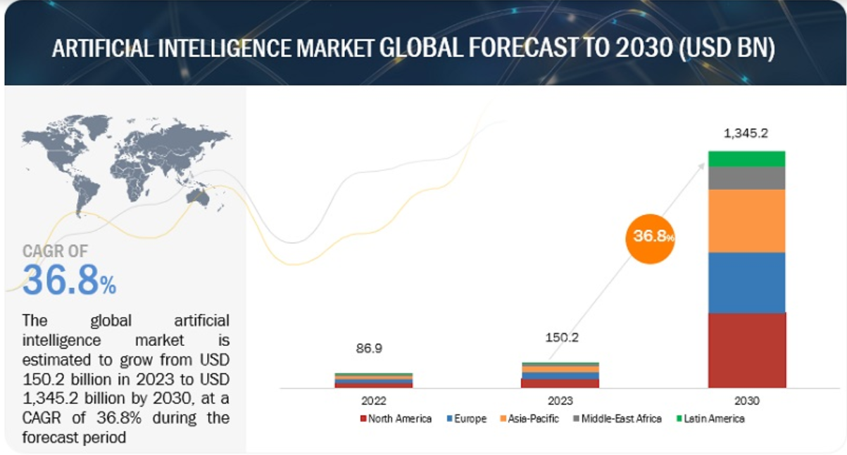
Market Size of AI
Markets and markets

Slide 8
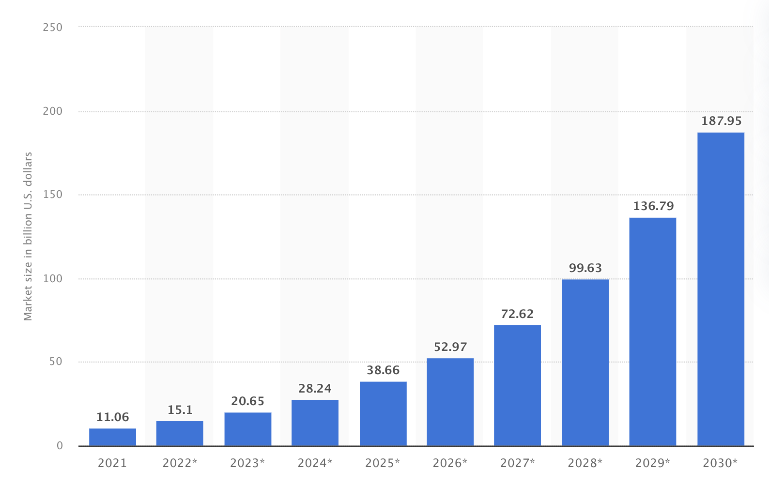
AI in Healthcare
Stewart

Slide 9
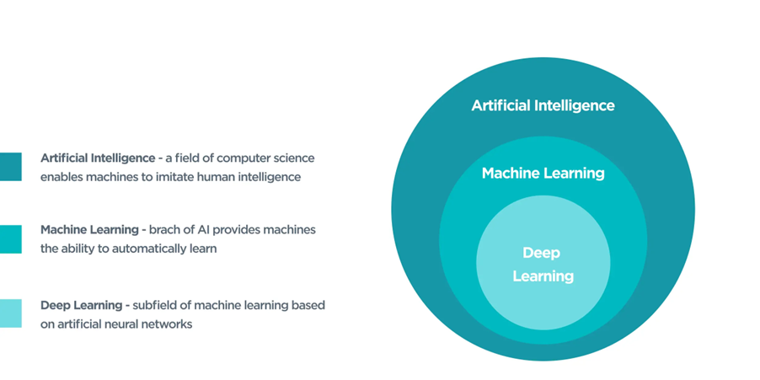
ByteAnt
“Machine Learning: Field of study that gives computers the ability to learn without being explicitly programmed.”
Arthur Samuel
AI does not always imply a learning-based system
e.g., Rule based system

Slide 10
Why AI not human ?
The problem size is too vast four human reasoning, calculating and memorizing capabilities
The problem needs to be addressed with minimum latency
The problem needs an accuracy rate which is not pragmatic for humans
The problem needs a lot of human resources, and it is possible to reduce costs using AI
The problem can be addressed by humans, but AI makes life easier !

Slide 11
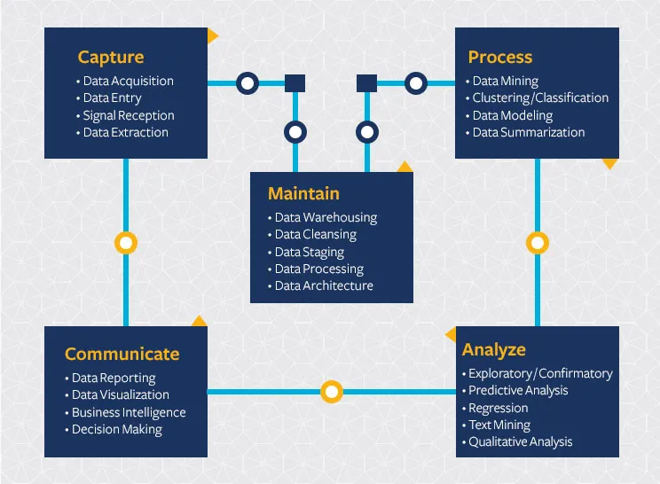
What is data science?
“The ability to take data — to be able to understand it, to process it, to extract value from it, to visualize it, to communicate it.”
Hal Varian
Berkeley

Slide 12
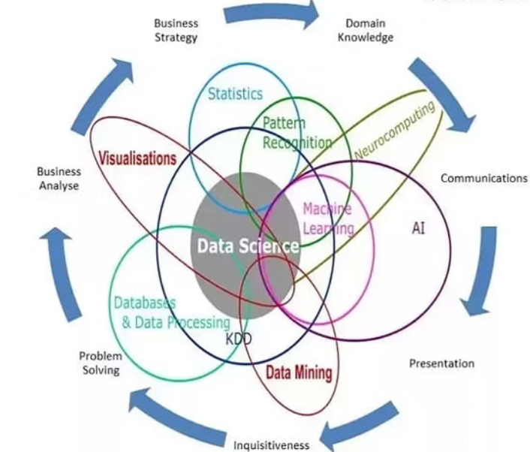
Data Science vs. Machine Learning
Data science is a broad term not only focuses on algorithms and statistics but also takes care of the entire data processing methodology includes data cleansing, and visualization. Machine learning is used in data science to help discover patterns in processing and analyzing data.
Tierney

Slide 13
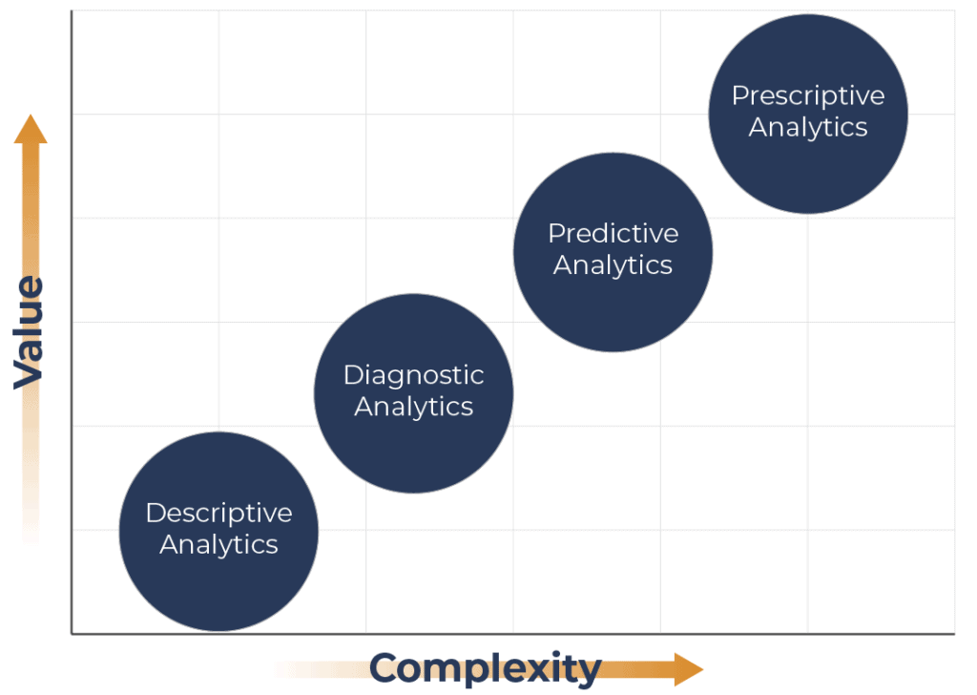
Analytics
What should be done?
What is likely to happen?
Descriptive
Decision support systems, Autonomous Systems
Why did it happen?
Regression, Classification
What happened?
Correlations, Cluster Analysis, …
Gartner
Visualizations, Reports, …
Hindsight
Insight
Foresight

Slide 14
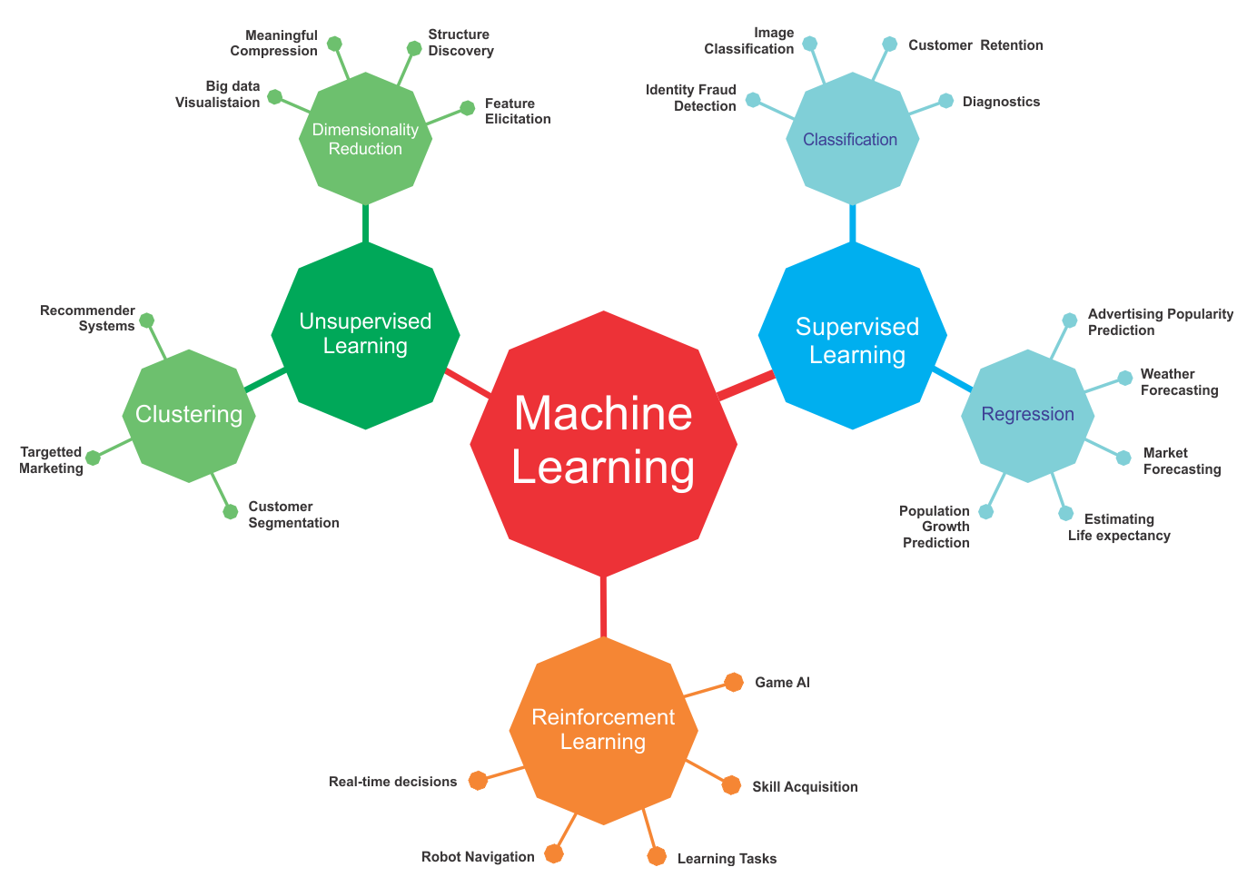
Learning using unlabeled data
Learning using labeled data
packt
Learning through Interactions with an environment

Slide 15
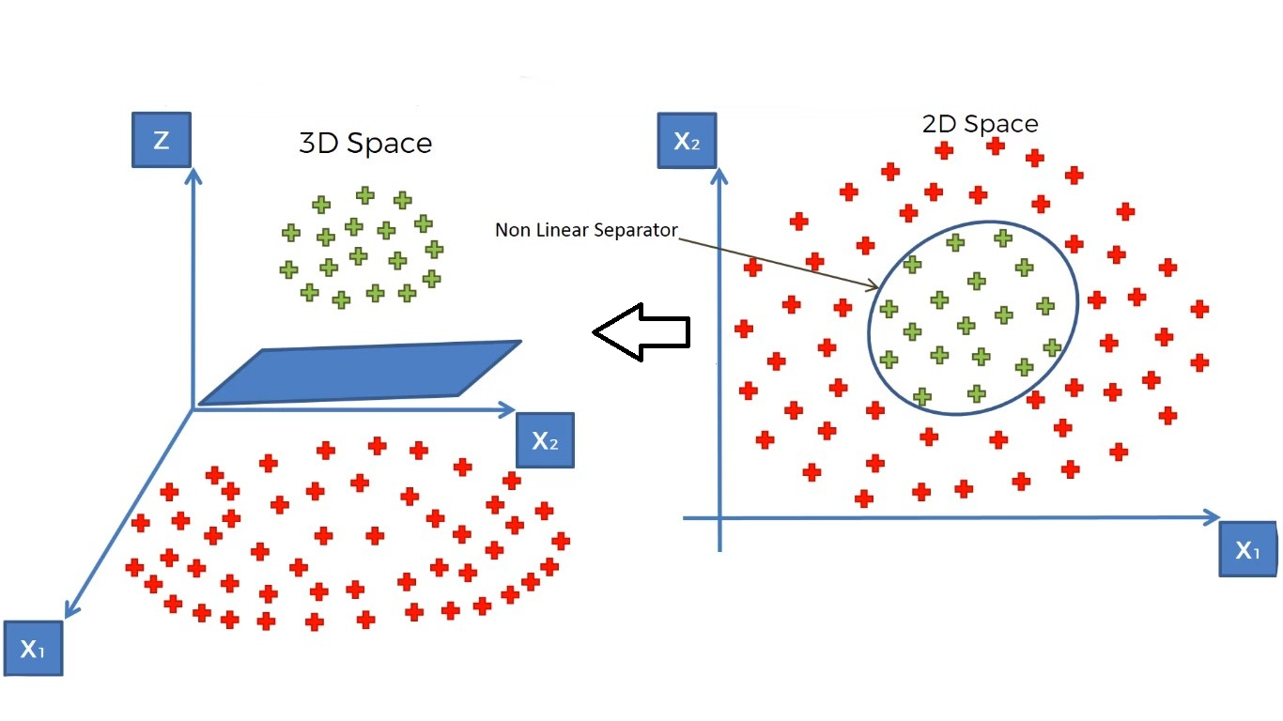
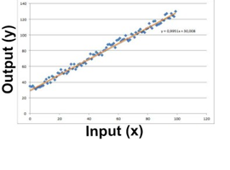
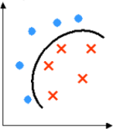
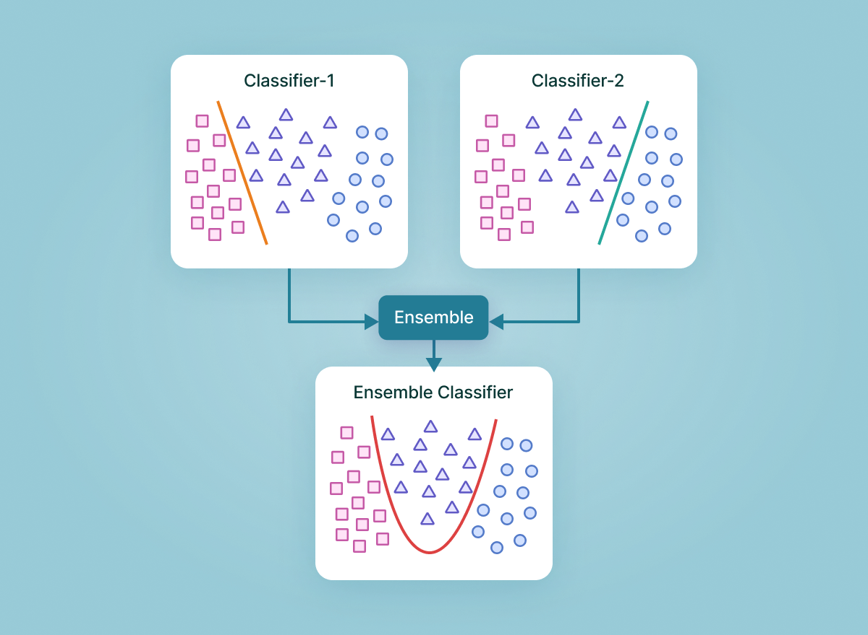
Some Supervised Approaches
Regression
Learn a line/curve (the model) using training data consisting of
Input-output pairs.
Use it to predict the outputs for new inputs
Linear Regression
Logistic Regression,
Support Vector Machines
SVM
Support Vector Machine (SVM) models have the ability to perform a non-linear regression / classification by mapping their inputs into high-dimensional feature spaces
Classification
Learn to separate different classes (the model) using training data consisting of input-output pairs
Use it to identify the labels for new inputs
Ensembles
Ensemble methods are machine learning techniques that combines several models in order to produce optimal models
Two-Class Nonlinear Classification
Support Vector Machines, Decision Trees,
Neural Networks

Slide 16








A Typical Supervised Learning
Labeled Training Data
“dog”
“dog”
“dog”
“dog”
“dog”
“cat”
“Features”
“dog”
“cat”
“cat”
“cat”
“cat”
The feature extraction phase may be part of the machine learning algorithm itself
“cat”
Training
Cat=0
Unknown Data /
Test Data
Classification Model
Predicted Label
Dog=1
“Features”
Production /
Testing

Slide 17
Training Model
Our training data comes in pairs of inputs (x,y)
D={(x1,y1),…,(xn,yn)}
xi: input vector of the ith sample (feature vector)
yi: label of the ith sample
D: Training dataset
The goal of supervised learning is to develop a model h:
h(xi)≈yi for all (xi,yi)∈D

Slide 18
Training Steps
1-selecting the type of machine learning algorithm appropriate for a particular learning problem. This defines the hypothesis class H, i.e. the set of functions we can possibly learn.
2- finding the best function within this class, h∈H that makes the fewest mistakes within our training data.
For step 2, we need to evaluate functions. This is where the loss function comes in.
A loss function evaluates a hypothesis h∈H on our training data and tells us how bad it is. The higher the loss, the worse it is
A loss of zero means it makes perfect predictions. It is common practice to normalize the loss by the total number of training samples, n, so that the output can be interpreted as the average loss per sample (and is independent of n).

Slide 19
Loss function
The goal of learning is to reduce the value of the loss function
In supervised learning, our training data provides us with the correct or desired output – known as the label – for each corresponding input.
The loss function compares the label against the output that our system currently predicts. A loss value of zero means perfect performance.

Slide 20
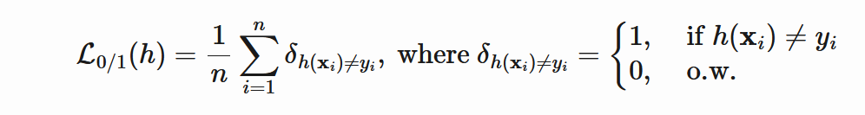
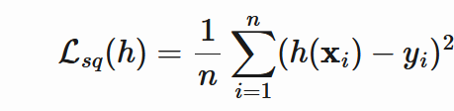
Zero-one loss
Squared loss
A function with near zero loss: Ideal ?

Slide 21
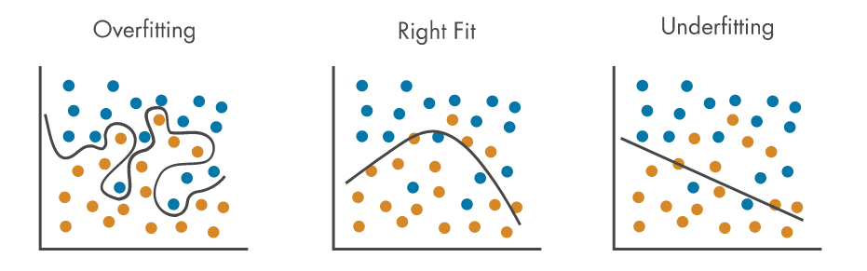
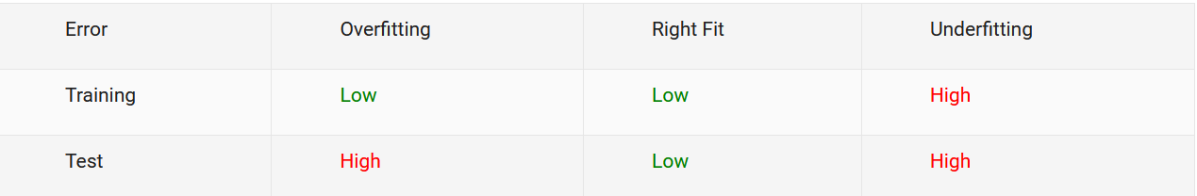
Overfitting
Mathworks
Our goal is not just to create a model that perform well on data used for training the model but also perform well for new / unseen data

Slide 22
Avoid Overfitting
Reducing Model Complexity (Techniques Depends on Model)
Feature Reduction
Train with more data
Ensembles / Super Learners
Using Validation Data
Etc.

Slide 23
Train / Test/ Validation
To resolve the overfitting issue, we usually split into three subsets:
Train
Test
Validation
Best practice:
Train : 70%-80%
Validation : 5%-10%
Test: 10%-25%

Slide 24
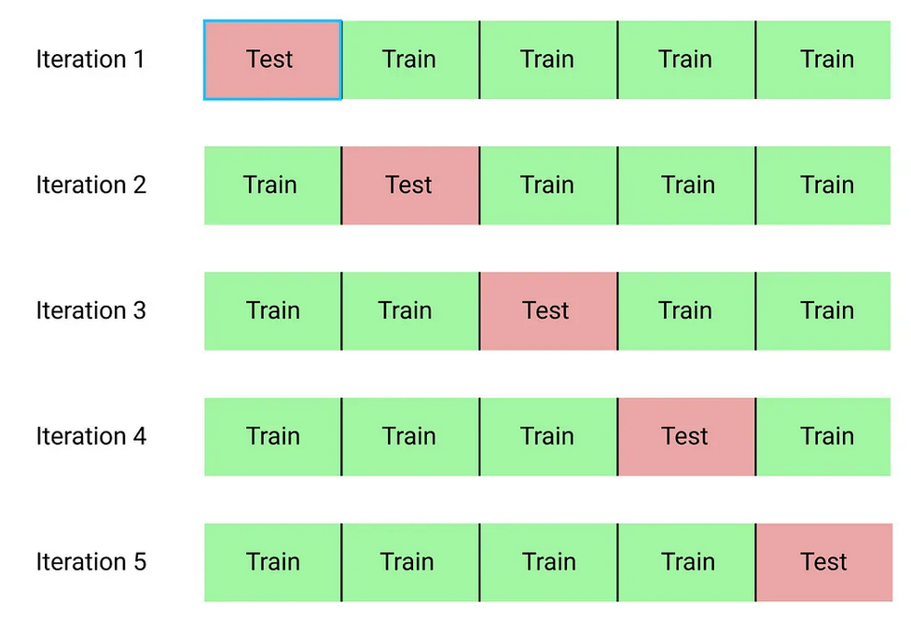
Cross-validation
1- split dataset into k groups (k-fold cross-validation), one of the groups as testing set and the others as the training set.
2- repeat this process until each individual group has been used as the testing set

Slide 25
Splitting Train and Test data
Train and test data should be separate completely
We should not touch test set during training
Before training/learning, randomly split train and test data
The test set must simulate a real-world scenario using unseen data
Avoid over-sampling , under-sampling, etc. on test data

Slide 26
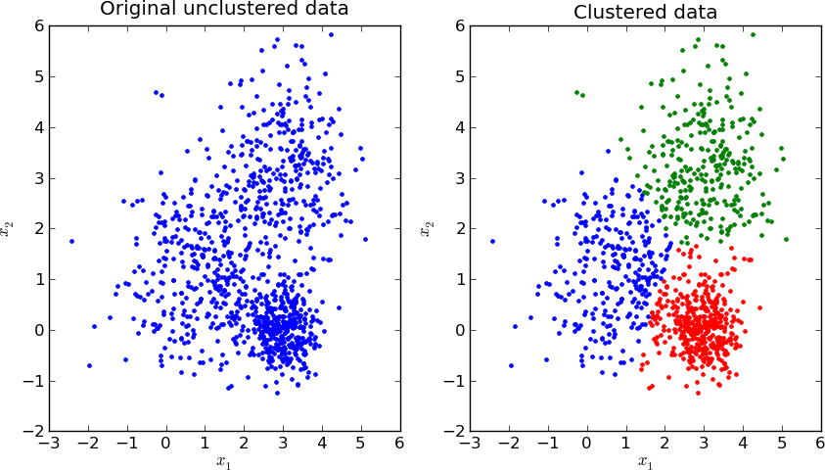
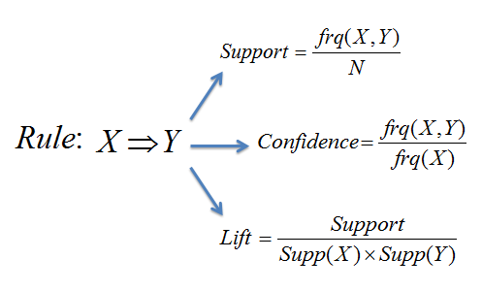
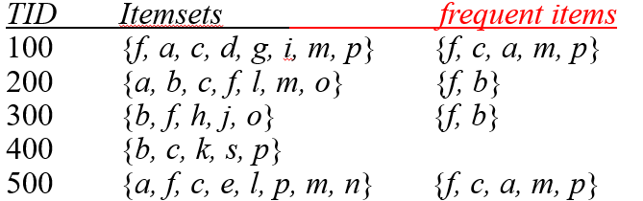
Some Unsupervised Approaches
Clustering
Learn the grouping structure for a given set of unlabeled inputs
k-Means, Hierarchical Clustering, ...
Association Rules
Association rule mining is a rule-based machine learning method for discovering interesting relations between variables in transactional databases.
Apriori, FP-growth, …

Slide 27
A Typical Unsupervised Learning
Unlabeled Data
“Features”
Clustering
Model
Cluster 1
Cluster 2

Slide 28
Training in Supervised vs Unsupervised
In supervised learning we deal with pairs of features and labels
Goal is to predict labels from features using a ML model
In unsupervised learning, we deal with features without labels
Goal is to build a model, in order to:
Reveal structure of data
Detect similarities / distances
Detect anomalies
Etc.

Slide 29
Loss Function in Supervised vs Unsupervised
Supervised learning
A loss function is used to choose a particular model with the lowest loss value
After training and testing the model, we don’t care about the loss function
Unsupervised learning
A loss function characterizes what the data looks like
The loss function is our data model, and is itself our primary goal

Slide 30
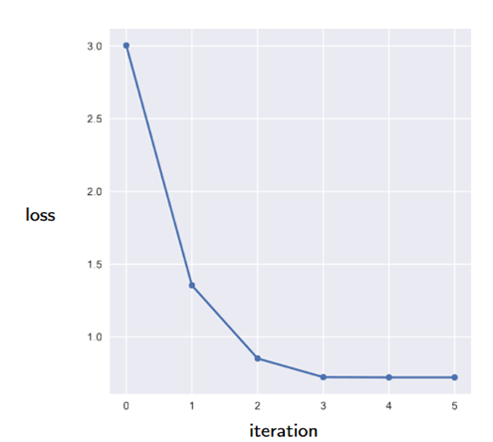
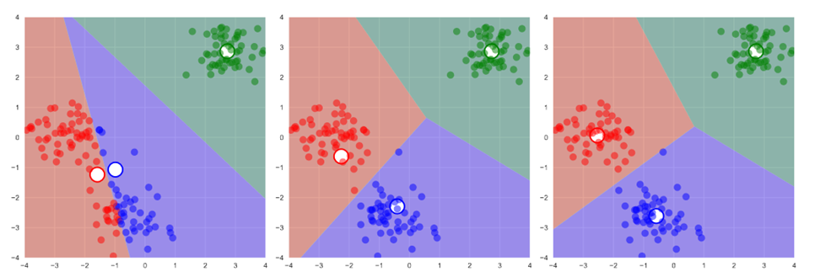
Example of Loss Function in Unsupervised
Clustering:
* Clustering models learns to group observations based on similarities between their features
* Loss function is defined as distance between observations
K-mean Clustering

Slide 31
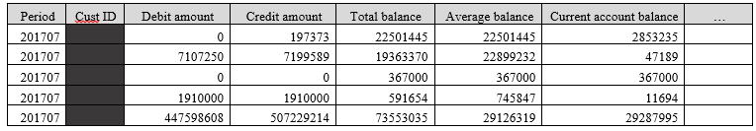
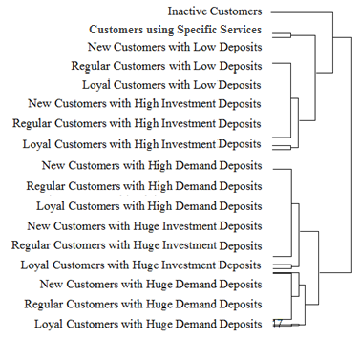
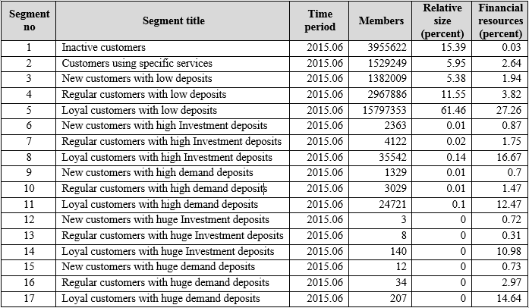
Semi Supervised
Labeled data is limited
Finding representations for supervised or other unsupervised models
Unlabeled data
Hierarchical Clustering
Using labeled data in other ML models

Slide 32
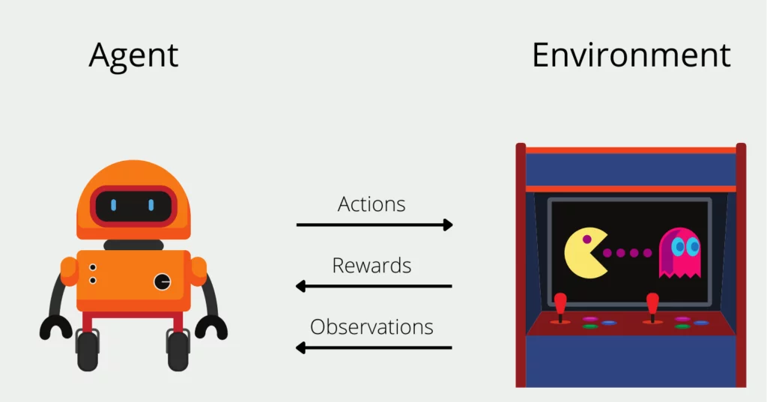
Reinforcement Learning
Database camp
Notes:
pet > you did good pet / you did bad

Slide 33
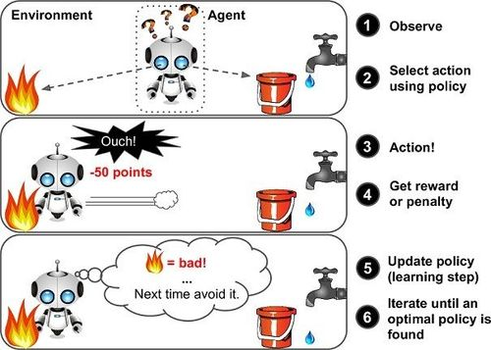
marutitech

Slide 34
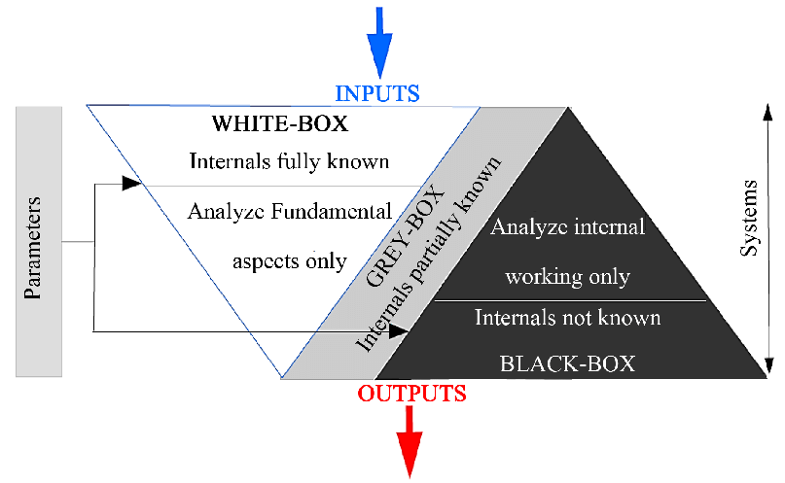
White-box vs. Black-box ML
Interpretable results for developing data-driven theories
Transparency makes more reliable results than opaque models
Explainable AI
High predictive accuracy
Highly complex models

Slide 35
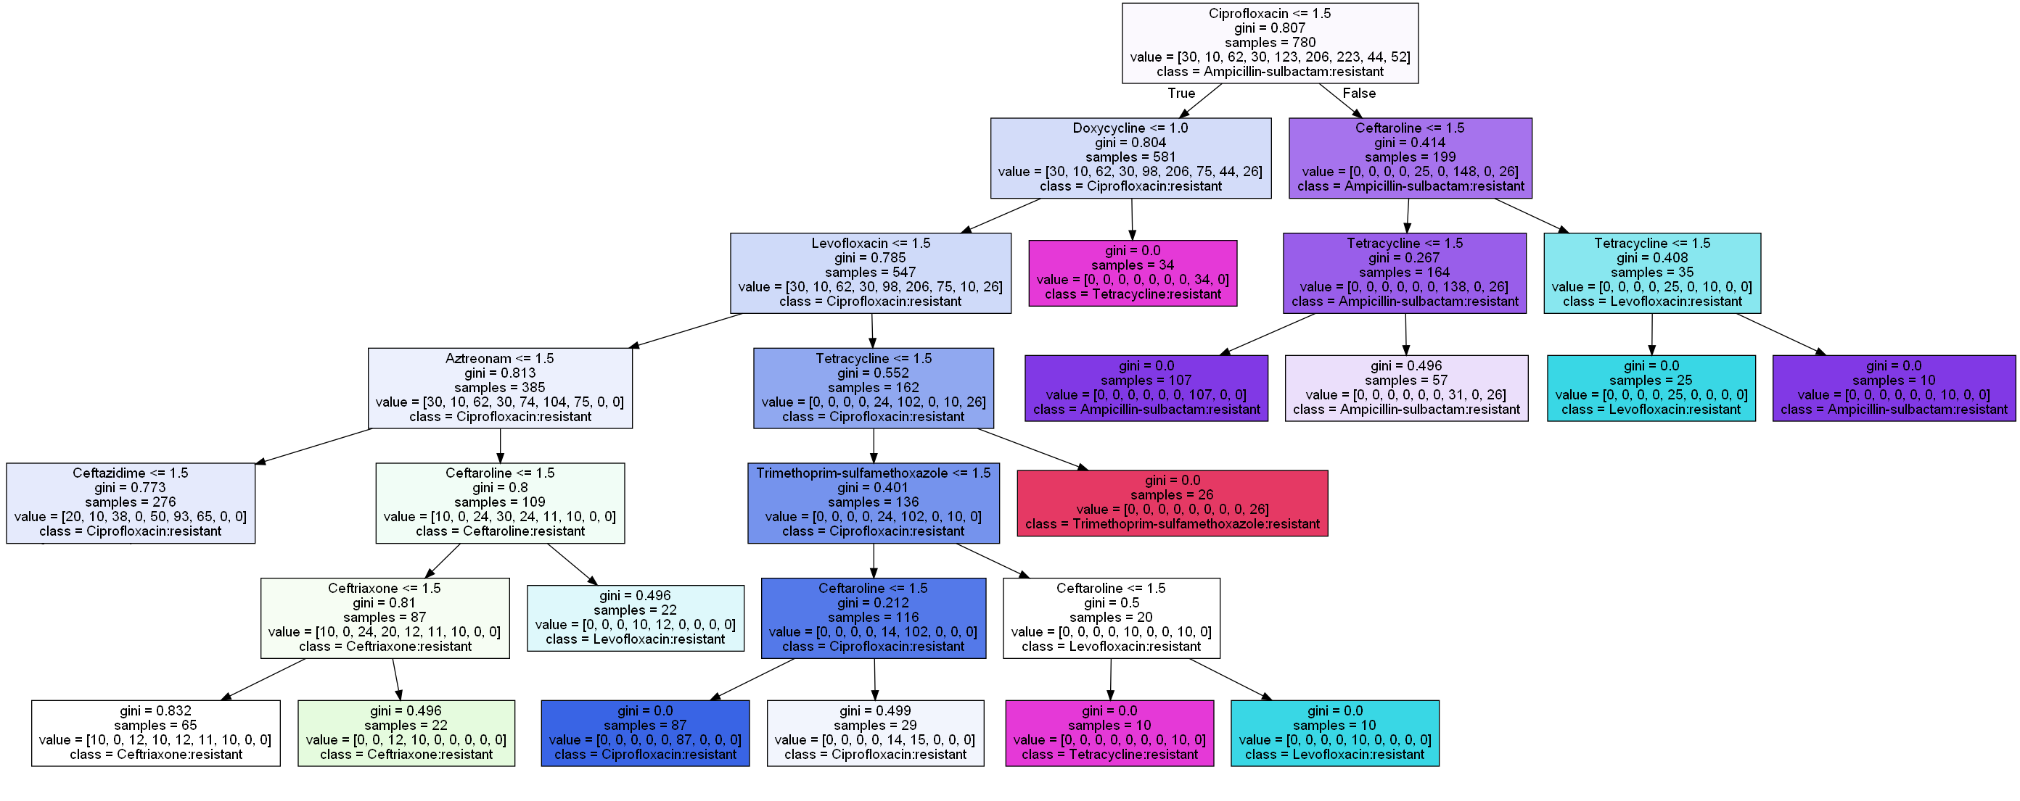
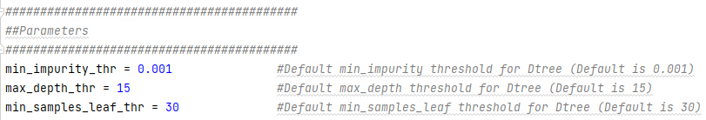
White-box Model Decision Tree (Predictive Model)
1-> Susceptible
2-> Intermediate
3-> Resistant
Hyperparameters

Slide 36
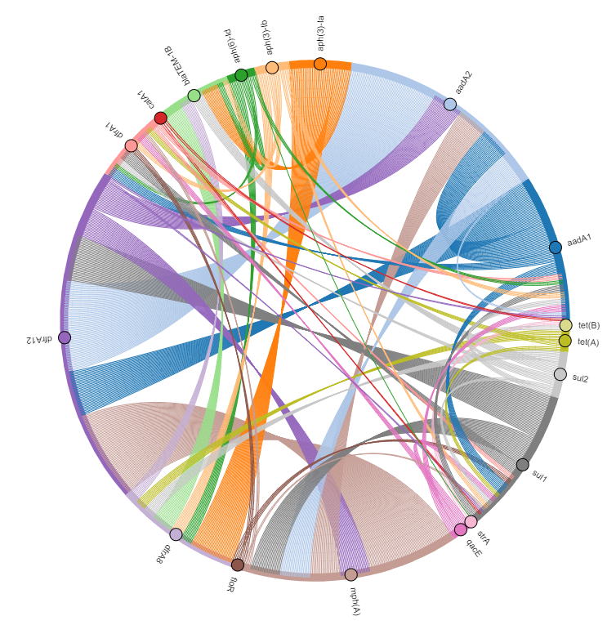
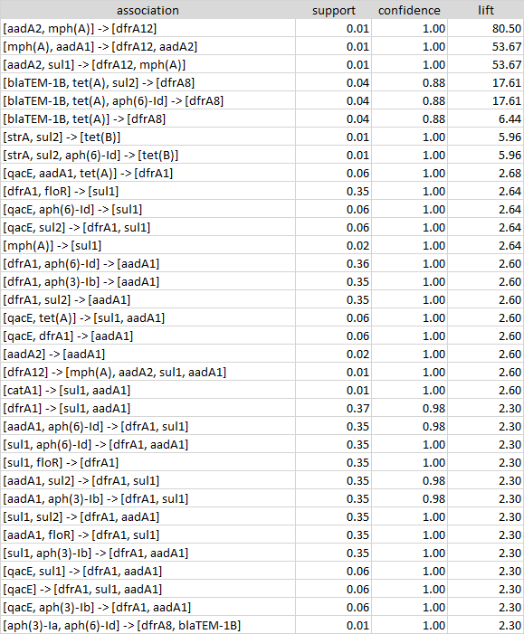
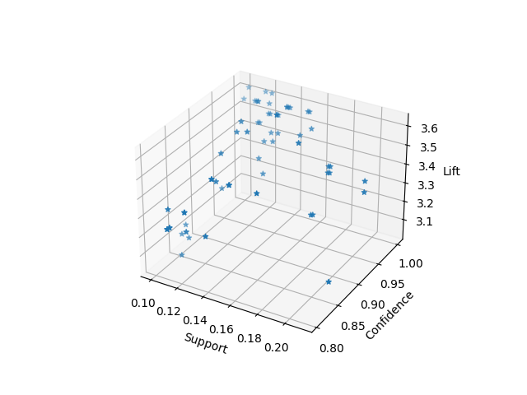
White-box Model Association Rules (Descriptive & Predictive Model)

Slide 37
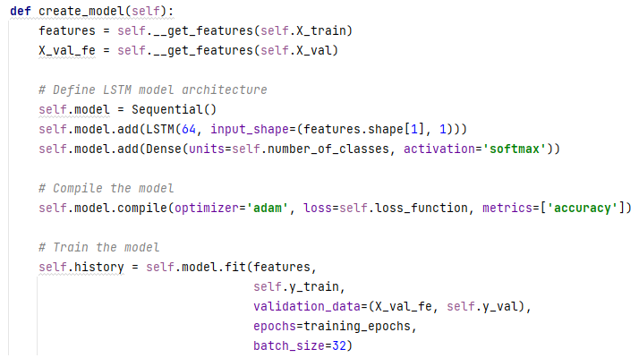
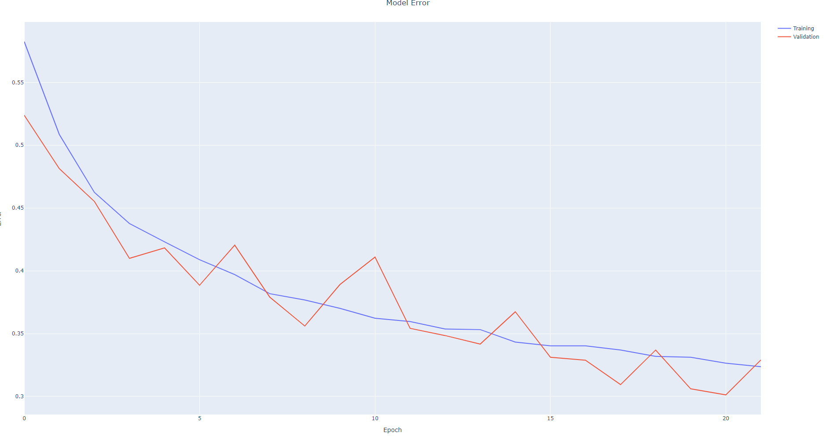
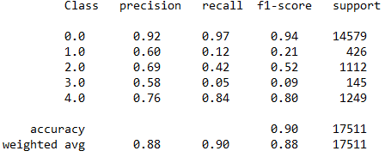
Black-box Model LSTM NN (Diagnostic Model)
ECG Classification

Slide 38



AI systems sometimes make mistakes Image Classification using a CNN
Class of Pic 1: Lion
Pic 1
Classification
Convolution
Class of Pic 2 : Lion
Pic 2
Max Pooling
Fully Connected Feedforward network
Same Class
Convolution
Same Features
Max Pooling
Flattened

Slide 39

Background knowledge Image Understanding by a Human Being
Wildlife
Town Square
Contains
Contains
Wild Animal
Is a Subject of
Sculpture
Is a
Lion

Slide 40
Solution: Integrating knowledge-bases with DNNs Moving from image classification towards image understanding
Wildlife Park
Has
Urban Area
Has
Town Square
Contains
Contains
Wild Animal
Is a Subject of
Sculpture
Is a
Lion
Image Processing Systems:
Object classified as a Lion
Supportive Positional System (e.g. GPS):
Approximate Location: National Park
Ontology:
National Park is a Wildlife Park
Wildlife Park Contains Wild Animals
Lion is an Animal
Results By the Proposed VPS :
Object classified as a Lion
Exact Position: Section A of National Park
Image Processing Systems:
Object classified as a Lion
Supportive Positional System (e.g. GPS):
Approximate Location: Central Square
Ontology:
Central Square is a Town Square
Town Square Contains Sculptures
Animals are Subject of Sculpture
Lion is an Animal
Results By the Proposed VPS:
Object classified as a Sculptures of Lion
Exact Position: In the Middle of Central Square

Slide 41
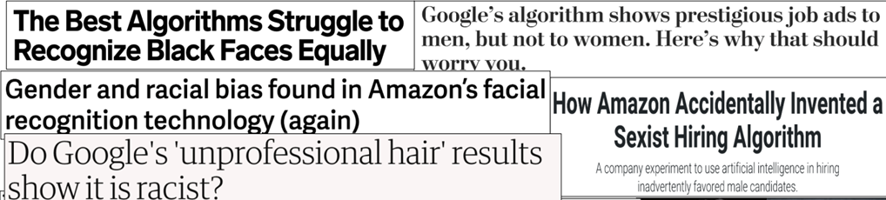
Ethical Issues in AI
Bias, Deep fake, Etc.

Slide 42
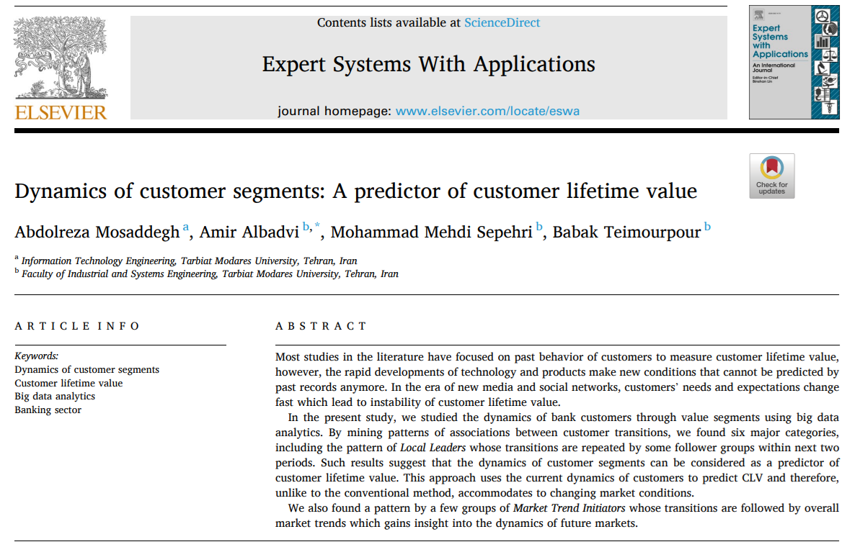
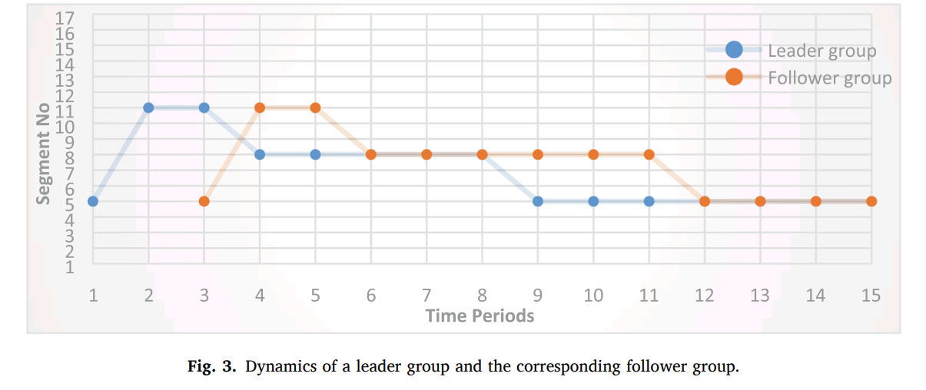
Ethical Issues in Big-data
There are some ethical considerations with the results. A customer without any default, may be judged from his/her linkage to a defaulter leader group. This aspect of the dynamics should be aligned with legal requirements and ethical standards.

Slide 43
Machine Learning is powerful, but it can be harmful. Be mindful about where and how to use this powerful technology!

Slide 44
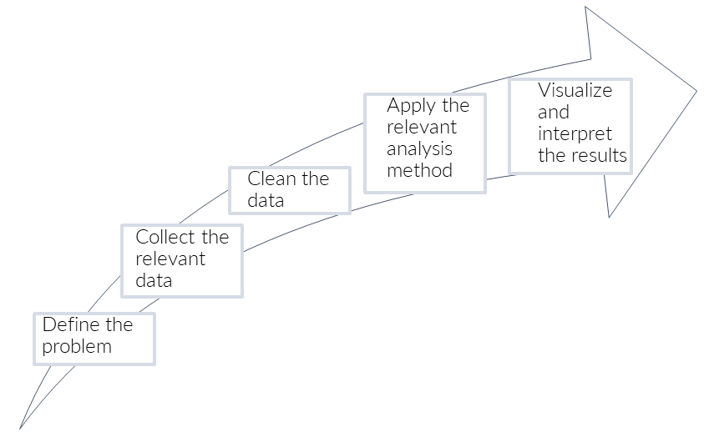
Data Analysis Steps

Slide 45
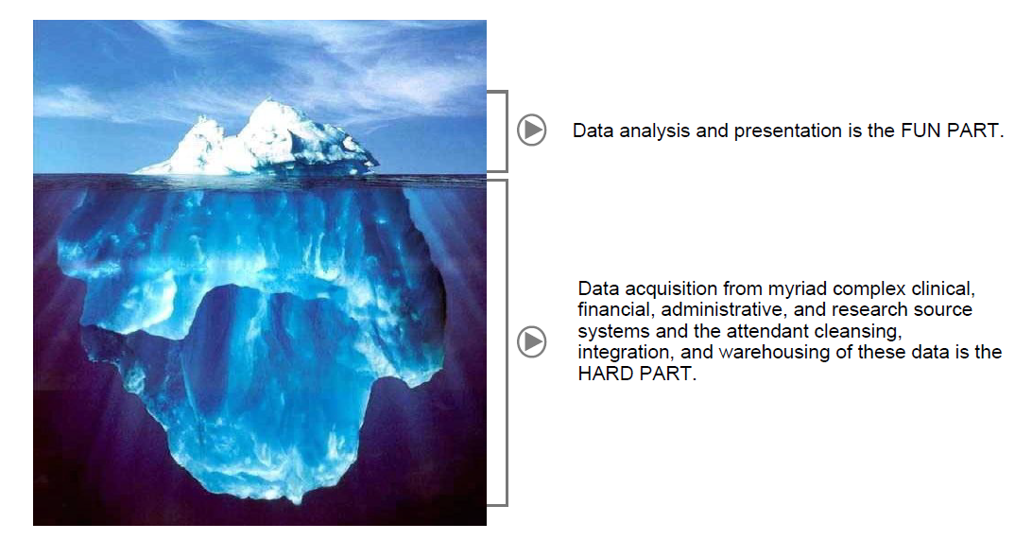
Oracle
“Cleaning and preparing the proper data for analysis can take up to 80% of a data scientist’s time.”
IBM

Slide 46
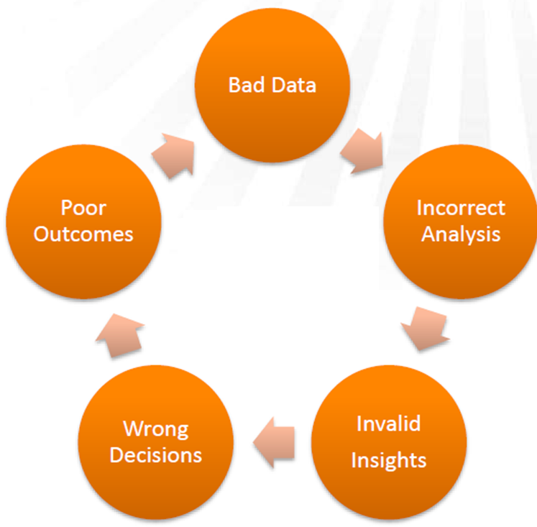
Why Data Preprocessing?
Usually, data in the real world is not clean
incomplete: lacking attribute values, lacking certain attributes of interest, or containing only aggregate data
e.g., occupation=“ ”
noisy: containing errors or outliers
e.g., Salary=“-10”
inconsistent: containing discrepancies in codes or names
e.g., Age=“42” Birthday=“03/07/1997”
e.g., Was rating “1,2,3”, now rating “A, B, C”
e.g., discrepancy between duplicate records
Old Dominion

Slide 47
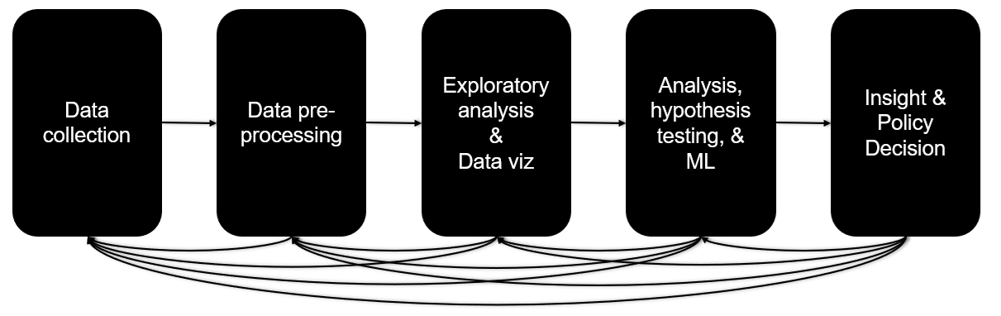
Data preprocessing
The process of transforming “raw” data into data that can be analyzed to generate valid actionable insights
Data preprocessing aka:
Data Wrangling
Data preparation
Data Cleansing
Data Transformation
Etc.
Data Lifecycle
Maryland

Slide 48
Major Tasks in Data Preprocessing
Data cleaning
Fill in missing values, smooth noisy data, identify or remove outliers, remove duplicates, resolve inconsistencies and discrepancies
Data integration
Integration of multiple databases, data warehousing
Data reduction
Dimensionality reduction
Numerosity reduction
Data transformation
Normalization
Discretization
Data Balancing, Data partitioning, etc.

Slide 49
Incomplete (Missing) Data
Data is not always available
E.g., have no recorded value for some attributes, such as customer income in sales data
Missing data may be due to
equipment malfunction
inconsistent with other recorded data and thus deleted
data not entered intentionally or due to misunderstanding
certain data may not be considered important at the time of design
not register history or changes of the data
Sometimes missing data may need to be inferred

Slide 50
Impute Missing Data
Ignore the tuple: not effective when many records have missing values or dataset is small
Fill in the missing value manually: not feasible when there are many missing values
Fill in it automatically with
a global constant value: e.g., 0, “unknown”, a new class
last reported value in historical data: assumes no change, which is usually wrong
value of a record with similar other attributes (Hot Deck Imputation)
the attribute mean
the attribute mean for all samples belonging to the same class / group
Imputation using prediction models: predict value of missing data using values of other attributes by a prediction model (e.g., regression)
Multiple Imputations (e.g., MICE)

Slide 51
Multiple Imputation with Chained Equations
Imputation Cycle:
Step 1: select one variable (usually with the least amount of missing data) as the target variable
Step 2: Impute the missing values in other variable with temporary "place holder" values derived from the non-missing values of each variable. (e.g., mean of values)
Step 3: Impute missing values of the target variable with predicted values by other variables using a prediction model (e.g., regression)
Step 4: repeat steps 1-3 for other variables
Imputation Cycle can be repeated (e.g., 5 or 10)
It stops after a number of cycles or when convergence is reached (the difference between the last two imputed values is zero or very small)

Slide 52
MICE
cran.r-project

Slide 53
MICE in Python
import pandas as pd from sklearn.experimental import enable_iterative_imputer from sklearn.impute import IterativeImputer input_dataframe = pd.read_csv("original_dataset.csv") print(input_dataframe) imputer = IterativeImputer(max_iter=10, random_state=0) imputed_dataset = imputer.fit_transform(input_dataframe) imputed_dataframe = pd.DataFrame(imputed_dataset, columns=input_dataframe.columns) print(imputed_dataframe)

Slide 54
Noisy Data
Noise: random incorrect values in a measured variable
Incorrect attribute values may be due to
faulty data collection instruments
data entry problems
data transmission problems
inconsistency in data
54
Notes:
54

Slide 55
How to Handle Noisy Data?
Binning
first sort data and partition into (equal-frequency) bins
then one can smooth by bin means, smooth by bin median, smooth by bin boundaries, etc.
Regression
smooth by fitting the data into regression functions
Clustering
detect and remove outliers
Combined computer and human inspection
detect suspicious values using queries and check by human (e.g., deal with incorrect values)

Slide 56
Binning (Discretization)
Equal-width (distance) partitioning
Divides the range into N intervals of equal size: uniform grid
if A and B are the lowest and highest values of the attribute, the width of intervals will be: W = (B –A)/N.
The most straightforward, but outliers may dominate presentation
Equal-depth (frequency) partitioning
Divides the range into N intervals, each containing approximately same number of samples
Good data scaling
In Python : pandas.qcut(data, number_of_bins)

Slide 57
Binning Sample
Sorted data : 4, 8, 9, 15, 21, 21, 24, 25, 26, 28, 29, 34
* Partition into equal-depth bins:
- Bin 1: 4, 8, 9, 15
- Bin 2: 21, 21, 24, 25
- Bin 3: 26, 28, 29, 34
* Smoothing by bin means:
- Bin 1: 9, 9, 9, 9
- Bin 2: 23, 23, 23, 23
- Bin 3: 29, 29, 29, 29
* Smoothing by bin boundaries:
- Bin 1: 4, 4, 4, 15
- Bin 2: 21, 21, 25, 25
- Bin 3: 26, 26, 26, 34

Slide 58
Outliers
Why do we care?
Can influence results of study
r = -.426
r = -.567
Same data, changed one value from 37 to 150

Slide 59
Identifying Outliers
Identify outlier on final version of variables
E.g., After imputation
Values that are greater than +3 standard deviations from the mean, or less than -3 standard deviations can be considered as outliers
SD of [34,35,41,56,71,75] = 16.53
M = 52.0
M + 3 SD’s = 101.06
SD of [34,35,41,56,71,150] = 40.37
M = 64.5
M + 3 SD’s = 185.61
sometimes SD is influenced by extreme values. So, having extreme values makes it harder to detect extreme values

Slide 60
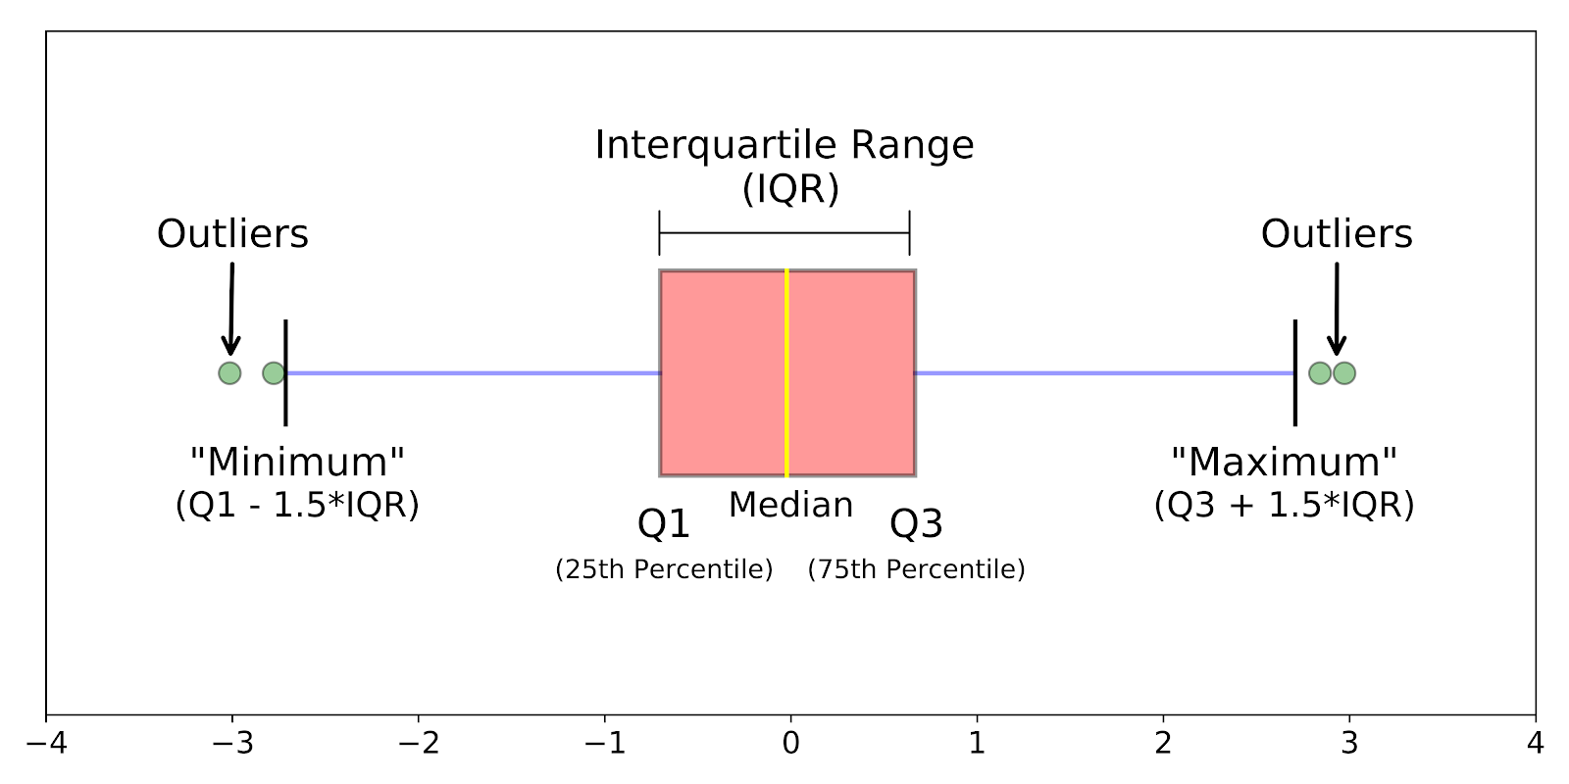
Boxplots
IQR (interquartile ) method
set up a “fence” outside of Q1 and Q3. Any values that fall outside of this fence are considered outliers.
To build this fence take 1.5 times the IQR and then subtract this value from Q1 and add this value to Q3
neptune
In Python : q3, q1 = numpy.percentile(data, [75 ,25])

Slide 62
Addressing Outliers
Outlier as a noncompliance (Invalid)
E.g., Negative age > Delete the outlier
Outlier as a real extreme value
E.g., Bill Gates salary > Deleting valid cases biases your sample
Outlier as output
E.g., detecting fraud > Outliers are outputs of process

Slide 63


Data Integration
Electronic Files
Different interfaces
Different data structures
Duplicate and inconsistent information
World
Wide
Web
Databases
IOT
Berkeley

Slide 64
Structure of Data
Semi - Structured
<Rec1> <Vehicle> Chevy </ Vehicle > <Engine> V8 </Engine></Rec1>

Slide 65
Goal: Unified Access to Data
Integration System
World
Wide
Web
Electronic Files
IOT
Databases
Collects and combines information
Provides integrated view, uniform user interface
Supports sharing

Slide 66
The Traditional Approach
Query-driven (lazy, on-demand)
Clients
Integration System
Metadata
. . .
Wrapper
Wrapper
Wrapper
. . .
Source
Source
Source

Slide 67
The Warehousing Approach
Clients
Data
Warehouse
Integration System
Metadata
. . .
Extractor/
Monitor
Extractor/
Monitor
Extractor/
Monitor
. . .
Source
Source
Source

Slide 68
Query-Driven vs Data-warehouse
Disadvantages:
Slow in query processing
Unavailable information sources
Inefficient and potentially expensive for frequent queries
Complex integration
Not common in industry
Advantages:
Rapidly changing information
Rapidly changing information sources
Truly vast amounts of data from large numbers of sources
Clients with unpredictable needs

Slide 69
Data Transformation
A function that maps the entire set of values of a given attribute to a new set of replacement values
Smoothing
Aggregation and Summarization
Normalization: Scaled to fall within a smaller, specified range
min-max normalization: preserve scale but does not handle outliers well
New value = (Original value - Min) / (Max - Min)
In Python: preprocessing.MinMaxScaler()
z-score normalization: better handling of outliers but not exact same scale
New value = (Original value - Mean) / Standard deviation
In Python: preprocessing.StandardScaler()
Normalization can help to reduce the impact of outliers by scaling the data to a common scale, which can make the outliers less influential.
Normalization can result in a loss of information in some datasets.
Notes:
69

Slide 70
Exploring Data - Statistics
Information that give a quick and simple description of the data:
Maximum value
Minimum value
Range (max – min)
Mean
Median
Mode
Quantile
Standard deviation
Etc.

Slide 71
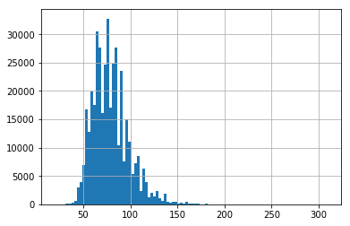
Exploring Data - Distribution
Histogram allows the inspection of the data for its underlying distribution
Notes:
The major difference is that a histogram is only used to plot the frequency of score occurrences in a continuous data set that has been divided into classes, called bins. Bar charts, on the other hand, can be used for a great deal of other types of variables including ordinal and nominal data sets.

Slide 72
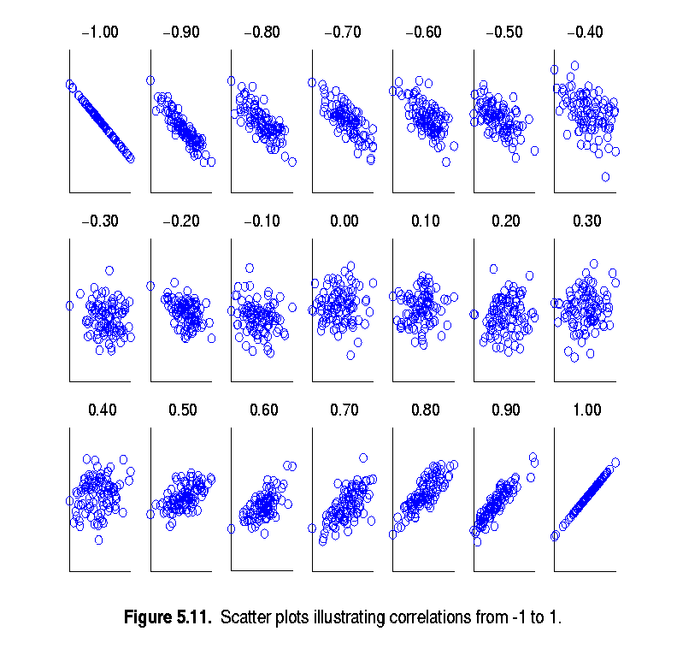
Exploring Data - Correlations
Scatter plots showing the correlations between two features
(from –1 to 1)
In Python: matplotlib.pyplot. scatter(x, y)

Slide 73
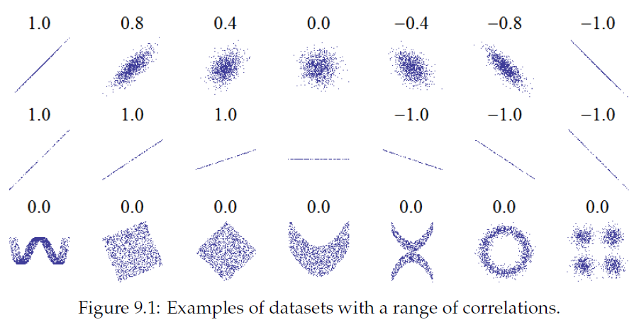
Correlation only measures linear relationship

Slide 74
Reference Books
1) Data Wrangling with Python by Jacqueline Kazil
2) Best Practices in Data Cleaning by Jason Osborne
3) Bad Data by Q. Ethan McCallum

Slide 75
Some Open Access Datasets
https://www.data.gov/
US-centric agriculture, climate, education, energy, finance, health, manufacturing data, …
https://cloud.google.com/bigquery/public-data/
BigQuery (Google Cloud) public datasets (bikeshare, GitHub, Hacker News, Form 990 non-profits, NOAA, …)
https://www.kaggle.com/datasets
Microsoft-owned, various (Billboard Top 100 lyrics, credit card fraud, crime in Chicago, global terrorism, world happiness, …)
https://aws.amazon.com/public-datasets/
AWS-hosted, various (NASA, a bunch of genome stuff, Google Books n-grams, Multimedia Commons, …)

Slide 76
Assignment 1
Study data definitions and explore data in ds_dataset.csv to gain insight into the data then develop a code using a common programing language (Python, R, Java, C#, C++, etc.) over this dataset for data cleansing and describe and document each step.
File name of Code : HW1_1_Code.[file type]
File name of Result : HW1_1_Result.docx
File name of Description : HW1_1_Method.docx

